Slide 1

Image Deblurring
MSDS 692 Data Science Practicum I

Slide 2
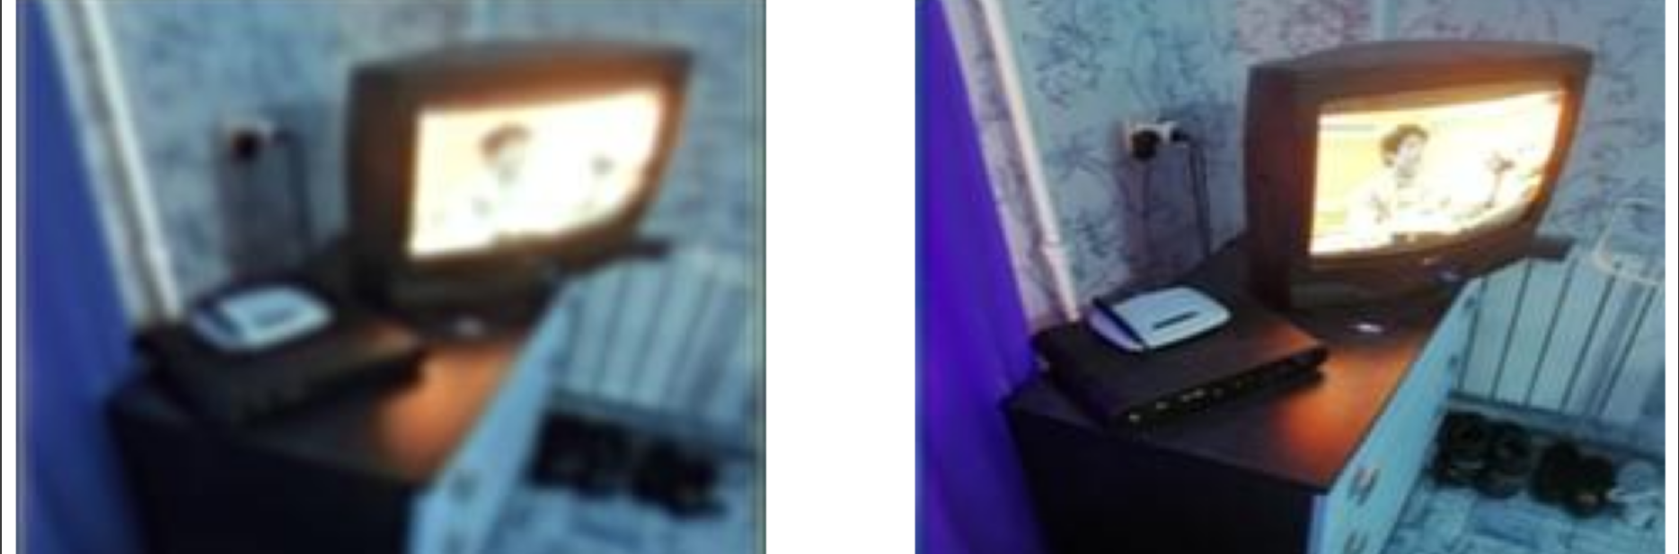
Blurred image → Unblurred image

Slide 3
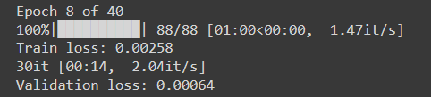
Convolutional Neural Network Flow
Train
Validation
Validation Saved Image
Weights Adjusted
Next Epoch
One Epoch = A complete pass through the algorithm
Example epoch
Per Epoch
Weights adjusted after a pass for the next pass (epoch)

Slide 4
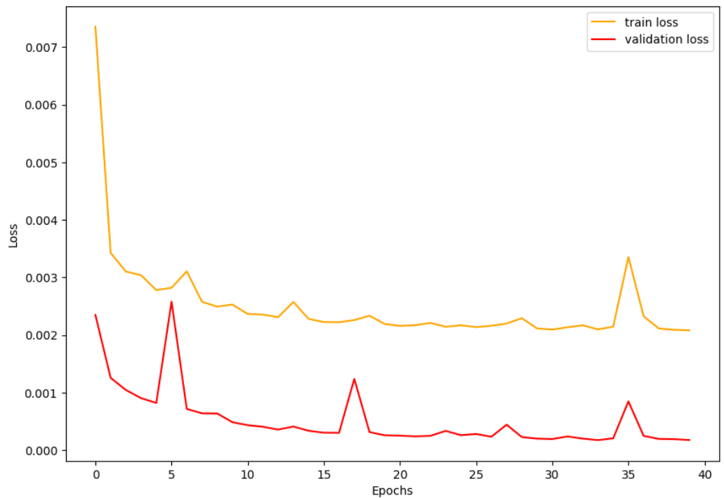
Model Evaluation Mean Squared Error (MSE) Loss
Loss (error) Function: quantifies the difference between predicted and target outputs.
MSE Loss: function used for regression (continuous value predictions), not classification.

Slide 5
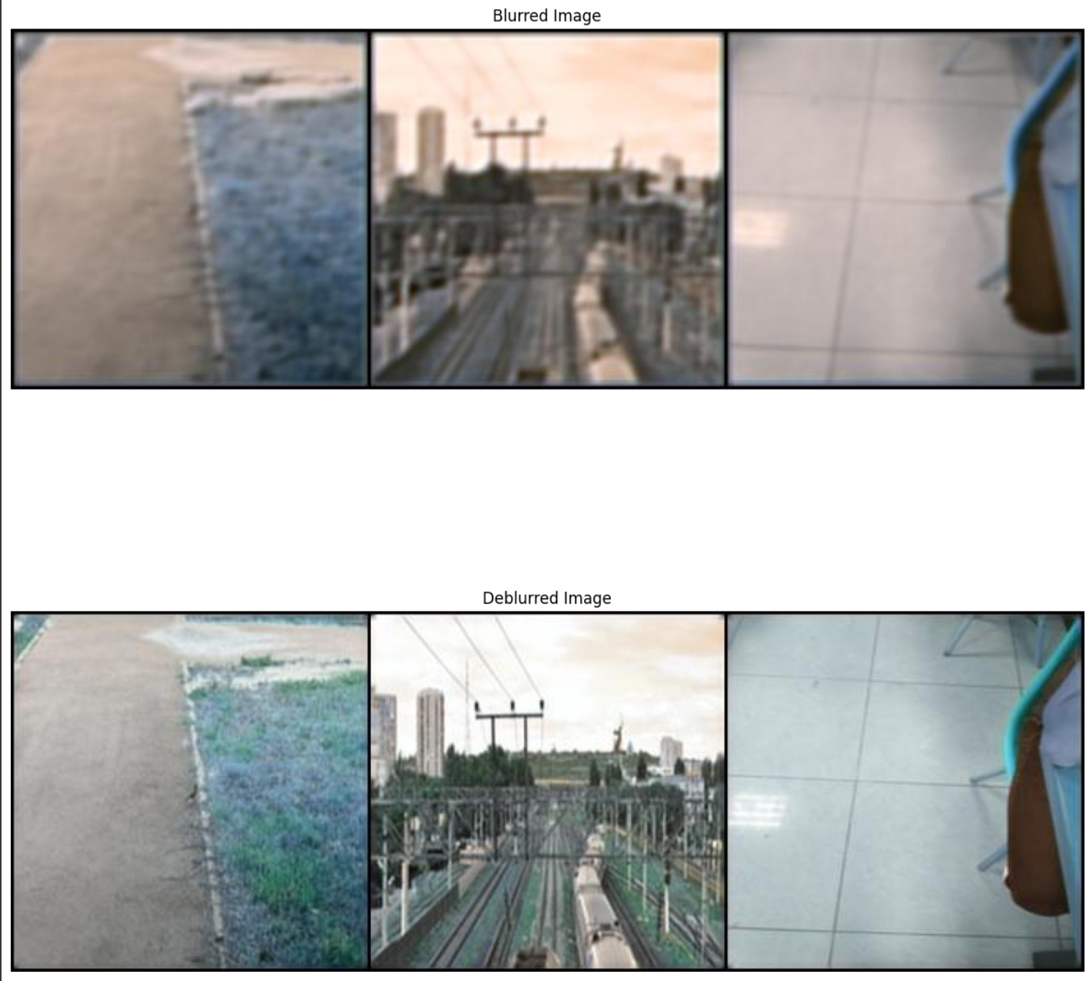
Multiple images deblurred

Slide 6
Next Steps
Data Science Practicum 2
Use different image datasets to validate
Create different models, including use of pre-trained models
Compare performance of all models
Create an application to use with final model

